Slide 1

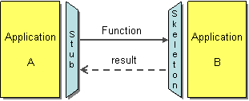
Remote Method Invocation

Slide 2

What is RMI?
RMI stands for Remote Method Invocation. It is a Java API that allows objects to invoke methods on other objects that are running in a different JVM.
This is useful for building distributed applications, where you need to have multiple applications communicating with each other.

Slide 3
RMI Architecture..
The RMI architecture is composed of several key components that work together to enable remote communication between Java objects.
Stub
The stub is a client-side proxy that represents the remote object. It implements the same remote interfaces as the remote object and forwards the method calls to the remote object over the network.
The stub handles the marshalling (packing) of the parameters, sending the request to the server, and unmarshalling (unpacking) the return values or exceptions.

Slide 4
RMI Architecture..
Skeleton
The skeleton is a server-side entity that receives the remote method calls from the stub, unmarshalls the parameters, invokes the appropriate method on the actual remote object implementation, and then marshals the return value or exception to send back to the stub.
Modern Java RMI
In modern versions of Java (since Java 2 SDK, v1.2), the need for explicitly generating skeletons is removed as the RMI runtime handles this automatically. Only the stub needs to be generated if you're not using dynamic proxies (introduced in Java 5).

Slide 5
RMI Architecture..
The RMI Registry
The RMI Registry in Java is a crucial component for the Java Remote Method Invocation (RMI) system. It acts as a simple directory service where remote objects can be registered and looked up.
The registry helps clients find remote objects using a name-based lookup mechanism.

Slide 6
RMI Architecture..
The remote interface
The remote interface in Java RMI is an interface that defines the methods that can be called remotely by clients.
This interface must extend java.rmi.Remote, and all the methods declared in it must throw java.rmi.RemoteException.

Slide 7
Working of RMI
When the client makes a call to a remote method, the stub intercepts the call and forwards it to the skeleton.
The skeleton then invokes the method on the remote object and returns the result to the stub. The stub then returns the result to the client.
RMI plays a crucial role in the development of distributed applications by simplifying the process of remote method calls.
It leverages Java's object-oriented capabilities to provide a seamless and robust solution for remote communication between Java applications.

Slide 8
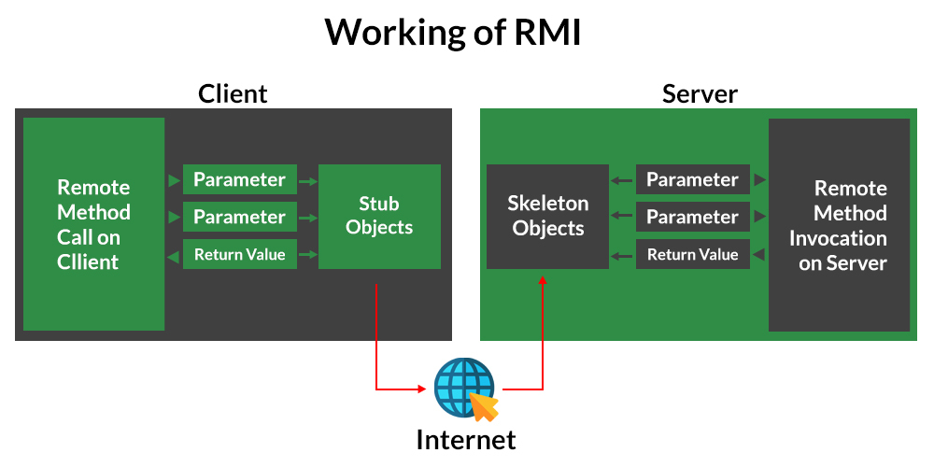

Slide 9
Steps to create basic RMI
Define the Remote Interface: Extend java.rmi.Remote and declare remote methods.
1
Implement the Remote Interface: Extend UnicastRemoteObject and implement the methods.
2
Create the Server: Instantiate the remote object and bind it to the RMI registry.
3
Create the Client: Lookup the remote object in the registry and invoke its methods.
4
Compile and Run: Compile the code, start the RMI registry, run the server, and run the client.

Slide 10
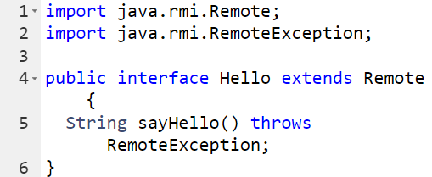
Creating RMI Applications
Creating an RMI application involves several steps. Here, we provide detailed code examples for each step.
Creating the remote interface:

Slide 11
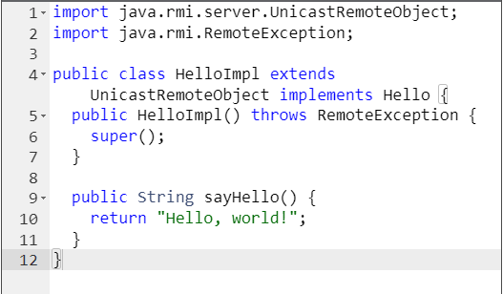
Implementing the remote interface:

Slide 12
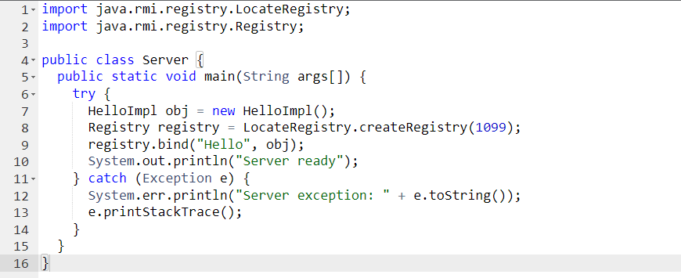
Creating the server program:

Slide 13
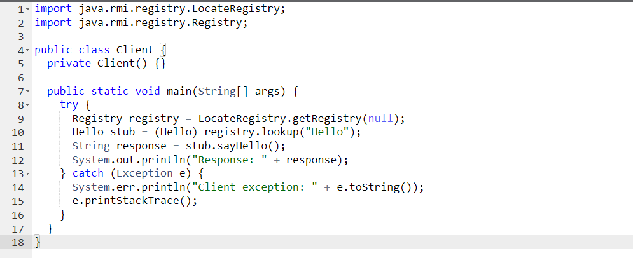
Creating the client program:

Slide 14

Running the RMI application:
Compile all the Java files.
Start the RMI registry using rmiregistry.
Run the server program.
Run the client program.

Slide 15
Advantages of RMI
Simplifies Communication: RMI makes it easy for Java programs to communicate over a network. It allows methods to be called on remote objects as if they were local.
Integration with Java: Since RMI is built into Java, it integrates seamlessly with Java applications. Developers can use familiar Java constructs and libraries.
Object-Oriented RMI allows passing of complex data types (objects) as parameters and return values, making it powerful and flexible.

Slide 16
Advantages of RMI..
Security Manager: RMI provides a security manager that can enforce access control policies, enhancing the security of remote interactions.
Memory Management: RMI takes care of memory management and garbage collection for remote objects, reducing the risk of memory leaks.
Remote Exceptions: RMI provides a mechanism to handle remote exceptions, making it easier to debug and manage errors in distributed applications.

Slide 17
Disadvantages of RMI
Limited to Java: RMI works only with Java. This limits its use in environments where multiple programming languages are used.
Difficult to Scale: For very large systems, managing many remote objects and their interactions can become complex and harder to scale.
Slower than Local Calls: Remote method calls are slower than local calls due to network latency and serialization/deserialization overhead.

Slide 18
Disadvantages of RMI..
Requires Reliable Network: RMI relies on a stable network connection. Network issues can lead to failures in remote method calls.
Network Configuration: RMI may face issues with firewalls and network configurations, as it requires specific ports to be open for communication.
Deployment Challenges: Setting up and configuring the RMI registry, handling security policies, and deploying remote objects can be more complex compared to local applications.

Slide 19
Group Members
1. Alferid Hassen....................................NSR/1452/14
2.Abdulkerim Jemal..............................NSR/429/14
3.Serkalem Delelegn.............................NSR/1967/14
4.Amanuel Markos.................................NSR/1458/14
5. Yordanos Eshetu.................................NSR/2772/14
6. Ephrem Demeke.................................NSR/2302/14

